Slide 1
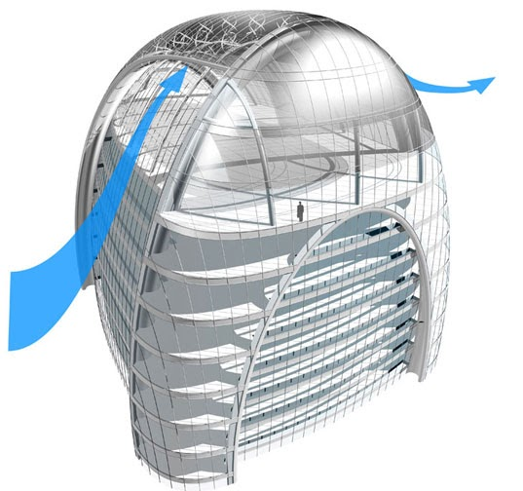
Framework : les 1
Clean Architecture
with .NET6
We should download and install Visual Studio Community 2022
https://visualstudio.microsoft.com/vs/community/

Slide 2
Framework : les 1
Agenda
Architecture & Design
Domain Layer
Application Layer
Persistence Layer
Infrastructure Layer
Presentation Layer

Slide 3
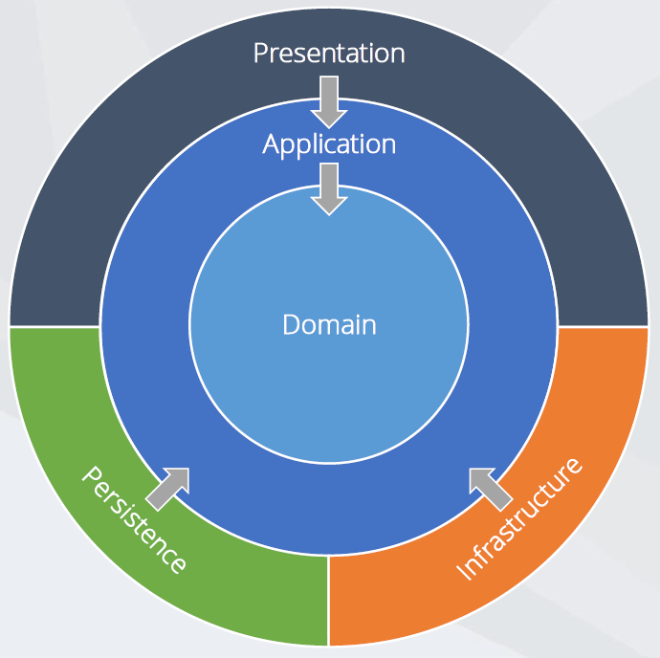
Framework : les 1
Overview
Independent of frameworks
Testable
Independent of UI
Independent of database
Independent anything external

Slide 4
Framework : les 1
Key Points
Domain contains enterprise-wide logic and types
Application contains business-logic and types
Infrastructure (including Persistence) contains all external concerns
Presentation and Infrastructure depend only on Application
Infrastructure and Presentation components can be replaced with minimal effort

Slide 5
Framework : les 1
Agenda
Architecture & Design
Domain Layer
Application Layer
Persistence Layer
Infrastructure Layer
Presentation Layer

Slide 6
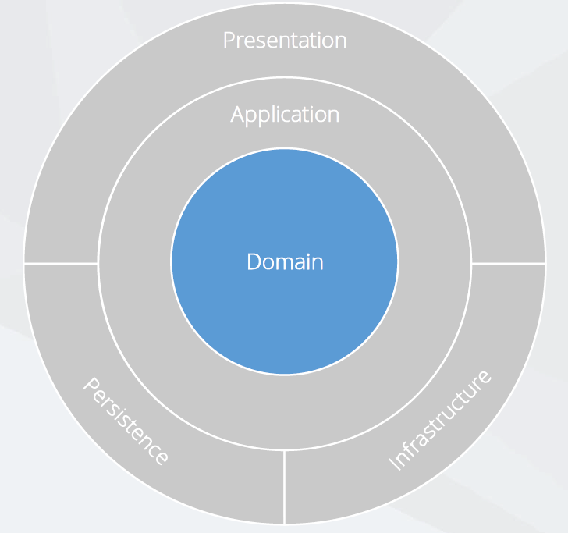
Framework : les 1
Overview
Entities
Enumerations
Logic
Exceptions

Slide 7
Framework : les 1
Demo
Reviewing the Domain layer

Slide 8
Framework : les 1
Key Points
Avoid using data annotations
Initialise all collections & use private setters
Create custom domain exception

Slide 9
Framework : les 1
Agenda
Architecture & Design
Domain Layer
Application Layer
Persistence Layer
Infrastructure Layer
Presentation Layer

Slide 10
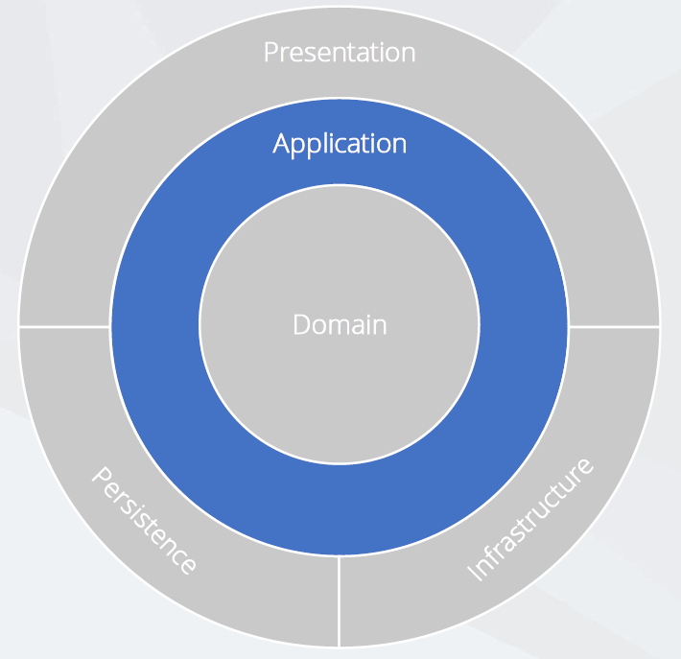
Framework : les 1
Overview
Interfaces
Models
Logic
Commands / Queries
Validators
Exceptions

Slide 11
Framework : les 1
CQRS
Command Query Responsibility Segregation
Separate reads (queries) from writes (Commands)
Can maximise performance, scalability
Easy to add new features, just add a new query or command
Easy to maintain, changes only affect one command or query

Slide 12

Framework : les 1
MediatR + CQRS =
Define commands and queries as requests
Application layer is just a series of request / response object
Ability to attach additional behaviour before and / or after each request, e.g. logging, validation, caching, authorisation and so on

Slide 13
Framework : les 1
Demo
Reviewing the Application layer

Slide 14
Framework : les 1
Key Points
Using CQRS + MediatR simplifies your overall design
Fluent validation is useful for all validation scenarios
MediatR simplifies cross cutting concerns
Independent of infrastructure and data access concerns

Slide 15
Framework : les 1
Agenda
Architecture & Design
Domain Layer
Application Layer
Persistence Layer
Infrastructure Layer
Presentation Layer

Slide 16
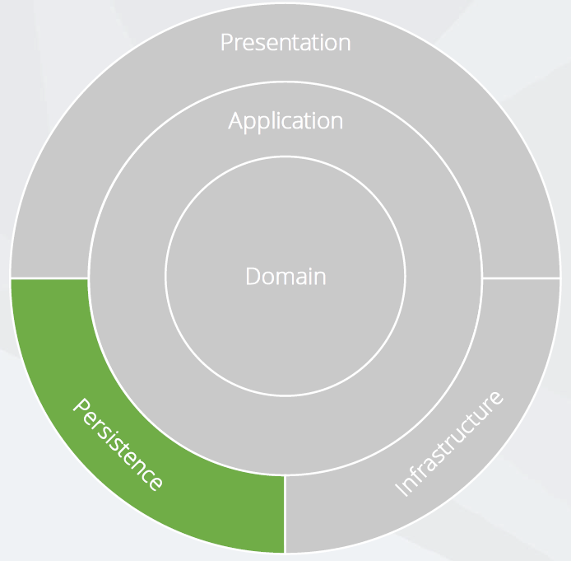
Framework : les 1
Overview
DbContext
Migrations
Configurations
Seeding
Abstractions

Slide 17
Framework : les 1
Unit of Work and Repository Patterns
Should we implement these patterns ?
It isn’t always the best choice, because :
EF .NET6 insulates your code from database changes
BbContext acts as a unit of work
DbSet acts as a repository
EF .NET6 has features for unit testing without repositories

Slide 18
Framework : les 1
Demo
Reviewing the Persistence layer

Slide 19
Framework : les 1
Key Points
Independent of the database
Use Fluent API Configuration over Data Annotations
Prefer conventions over configuration
Automatically apply entity type configurations

Slide 20
Framework : les 1
Agenda
Architecture & Design
Domain Layer
Application Layer
Persistence Layer
Infrastructure Layer
Presentation Layer

Slide 21
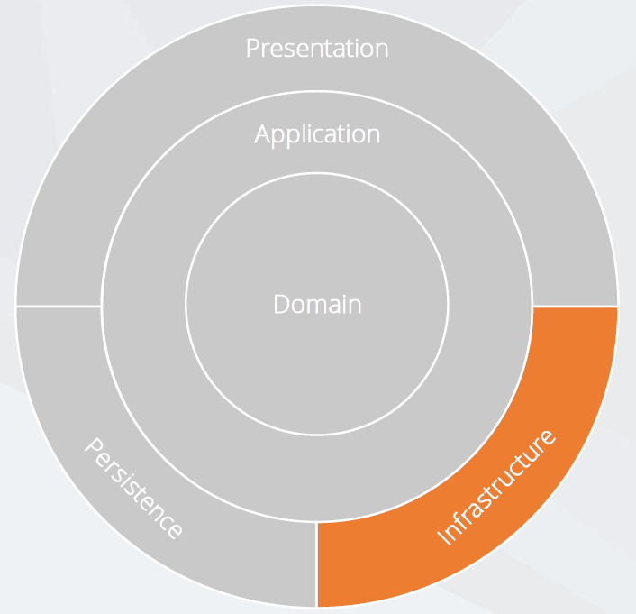
Framework : les 1
Overview
Implementations, e.g.
API Clients
File System
Email / SMS
System Clock
Anything external

Slide 22
Framework : les 1
Demo
Reviewing the Infrastructure layer

Slide 23
Framework : les 1
Key Points
Contains classes for accessing external resources
Such as file systems, web services, SMTP and so on
Implements abstractions / interfaces defined within the Application layer
No layers depend on Infrastructure layer, e.g. Presentation layer

Slide 24
Framework : les 1
Agenda
Architecture & Design
Domain Layer
Application Layer
Persistence Layer
Infrastructure Layer
Presentation Layer

Slide 25
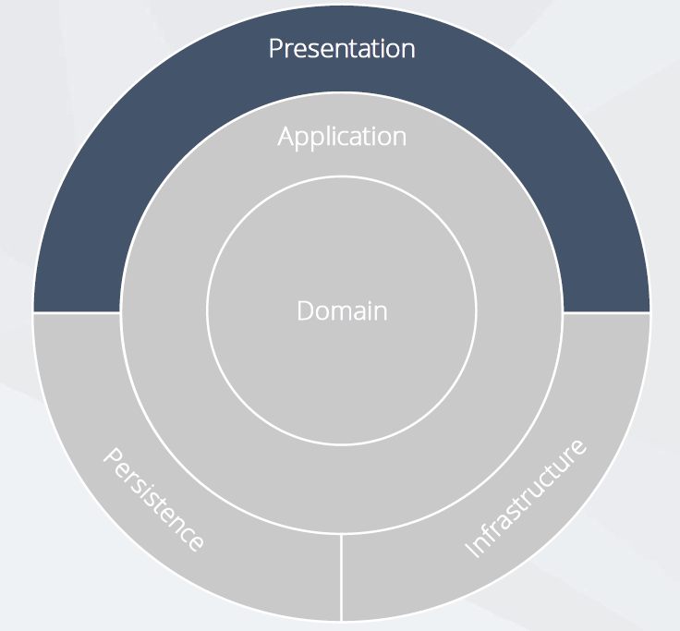
Framework : les 1
Overview
SPA – Angular or React
Web API
Blazor
Razor Pages
MVC
Web Form

Slide 26
Framework : les 1
Demo
Reviewing the Presentation layer

Slide 27
Framework : les 1
Key Points
Controllers should not contain any application logic
Create and consume well defined view models
Open API bridges the gap between the front end and back end

Slide 28

Framework : les 1
Questions ???

Slide 29
Framework : les 1
Assignment
The database of warehouse should be implemented

